Slide 1

To insert your company logo on this slide
From the Insert Menu
Select “Picture”
Locate your logo file
Click OK
To resize the logo
Click anywhere inside the logo. The boxes that appear outside the logo are known as “resize handles.”
Use these to resize the object.
If you hold down the shift key before using the resize handles, you will maintain the proportions of the object you wish to resize.
Enron Finland Energy
&
Vneshtopprom Exposure Analysis
Confidential
Attorney Client Privilege
Distribution
Rick Buy
Rick Causey
Mark Frevert
John Sherriff
Fernley Dyson
Ted Murphy
John Nowlan
Steve Young
Sally Beck
Tim Poullain-Patterson
John Sorrells
Nick Swingler
Kevin Sweeney

Slide 2

Table of Contents
Transaction Overview
Exposure Overview and Summary
What Went Wrong?
Next Steps
Revised Helsinki Business Model

Slide 3
Background to Greenergy Transaction
Enron purchased a portfolio of 12 Russian oil products contracts from Greenergy, some with a pre-financing component (e.g., Vneshtopprom), in August of 1998
  Pre-financing Exposure Limit for Total Portfolio: $15,000,000
  Total portfolio exposure at inception: $21,700,000
  Individual Counterparty Pre-financing Limit: $5,000,000 to $6,000,000.
  Vneshtopprom exposure at inception: $6,000,000
Purchase Price total: $8,000,000 ($4mm up front, 4 quarterly $1mm payments), fully amortized by September 1999.
Six employees hired by Enron, two-year employment agreements signed.
Notes:
##
*
*
07/16/96

Slide 4
Background to Current Exposure
Enron entered into fixed price transactions with Vneshtopprom and put on financial hedges against that fixed price exposure (Contracts dated April 30th, May 5th, June 8th)
Prepayments were made against these fixed price contracts as well as contracts agreed on a floating price basis
Export Ban on Russian fuel oil deliveries was announced in June 99, effective September 99
Deliveries were not up to contractual volume, and undelivered volume was rolled forward as were the financial hedges against that volume
Market prices have increased greatly over the time period May 99 to October 99
In November 99, senior Europe management inquired into the high exposure and decided that there would be no new prepayments and negotiations on recovery should begin for both the mark to market and prepayment exposure
During negotiations in January 2000, Vneshtopprom made accusations that they had been defrauded by Enron

Slide 5
Exposure Analysis - 12/31/99
Vneshtopprom USD’million
  Outstanding Pre Financing Balance 6.0
  Gross MTM recognised on fixed price deals 11.9
  Gross Exposure 17.9
  Less Balance written off in 1999 (4.2)
  Total Remaining Vneshtopprom Exposure 13.7*
Other Potential Exposure Items - (Maximum Impact)
  Take or Pay Storage Commitment 9.3**
  Severance Payments 0.5
  Office Closure Costs (Lease expense, IT infrastructure) 1.3***
  Unidentified Counterparty Claims 2.1
TOTAL EXPOSURE 26.9
* Provisions of $9.5 existed at 12/31/99, balance has been provided for in Q1 2000
** Current market quotes indicate a rate at or above the contract rate; sub leasing currently being investigated
*** The office could be utilized by EES and power trading if oil trading was relocated
Notes:
##
*
*
07/16/96

Slide 6
Summary of Altered Bills of Ladings Facts
Vneshtopprom supplied Enron with 60 Bills of Lading which they said were fraudulent versus 80 invoices received from them
Of the above, 22 related to the period April 99 through July 99
Using a typewriter ribbon, Enron has been able to validate that 20 of these were typed or altered in the office and relate to the 22 invoices
There were a total of 22 entries on the ribbon for the period of April through July, therefore only 2 or 10% possibly relate to other counterparties
Total volume moved through Finland office: 4,700,000 metric tons
Total Vneshtopprom Volume: 500,000 metric tons
Notes:
##
*
*
07/16/96

Slide 7
Calculation of Counterparty Claim Exposure
Vneshtopprom:
75% of 500,000 Metric Tons may have involved altered Bills of Lading
$2-$5 per Metric Tons gained from fraudulent activity
Potential Claim of $750,000 to $1,850,000
Other Pre-finance Counterparties:
Estimated to be 10% of Fraudulent activity
Volume other than Vneshtopprom is approximately 4,200,000 Metric Tons
$2-$5 per Metric Tons gained from fraudulent activity
Potential Claim of $840,000 to $2,100,000
Notes:
##
*
*
07/16/96

Slide 8
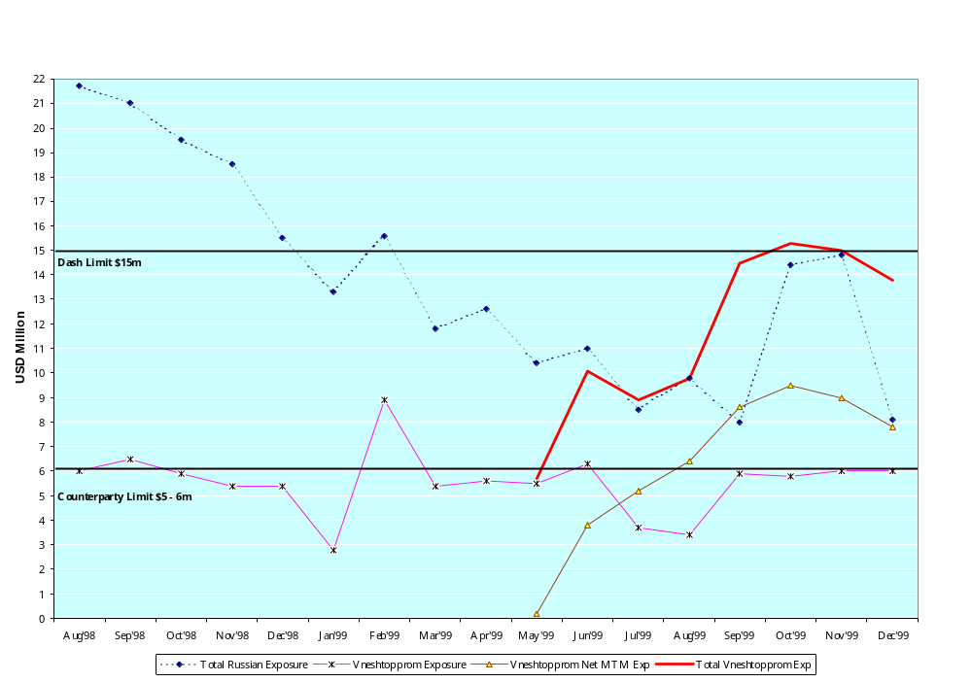
Russian Credit Exposure
Notes:
##
*
*
07/16/96

Slide 9
What Went Wrong?
Commercial head of trading group was also key stakeholder in origination effort
Over reliance on key commercial individuals and those individuals exercising undue influence on controls processes
Selective communication of facts by key commercial individuals
Lack of seasoned Enron commercial and energy operations presence and direction in Helsinki
Lack of appropriate follow-up on Bill of Lading issue after detection
  internal process changes could have been made
  notification of auditors through the BRM process
  set up of audit actions to monitor activity
Acknowledgement of confirmations and amendments to confirmations/contracts not obtained from pre-finance counterparties (e.g. on rolling forward of undelivered volume)
Telephone lines in office were not recorded
Volumetric and Valuation reconciliation was not done on a timely basis
Prepayment and MTM exposures were not aggregated for management reporting of credit exposure
No formal process for reporting of credit exposure limit violations
No formal process for review of main points in DASH before changing risk profile
Notes:
##
*
*
07/16/96

Slide 10
Next Steps
  Pursue negotiations with Vneshtopprom for settlement of outstanding amounts
  Negotiate sub-lease on take or pay storage agreement
  Implement revised Helsinki Office business model (see next slides)
Notes:
##
*
*
07/16/96

Slide 11
Helsinki Office Revised Business Model
Commercial Changes
Business Scope
  No prepay transactions (Already in place)
  Origination of product only upon the request of UK traders (Already in place)
Business Management Activities
  Activity will be managed by a London import*, reporting to John Nowlan
  All transactions to be approved by John Nowlan or his designee
  Regular on-site oversight by John Nowlan and Goran Novakovic
* London commercial manager to be determined by John Nowlan, should be in Helsinki by 1/31/2000

Slide 12
Helsinki Office Revised Business Model
Operational Changes
Business Management
  Logistics managed by London import to Helsinki (Graham Cane)
  Senior London operational controller imported to Helsinki (Richard Sage) (January 31, 1999)
  Risk Management Administration/Accounting overseen by London import to Helsinki (Paul Wallace) (Already in place)
  Senior accounting personnel from London to work in Helsinki for month end close each month
Business Process
  Add recorded lines for originators and logistics (in current office if feasible, otherwise in new office)
  Procedure manual for Helsinki business to be prepared and reviewed with all Helsinki and London Global Products personnel
  Confirmation to be reconciled to risk book prior to being sent to counterparties; form of confirmation to be reviewed by Legal
  Document retention procedures to be created, with a complete set of all documents to be retained in London and Helsinki
  Settlements processes to be reviewed and revised to provide additional controls

